Slide 1

Lauren Nichols
MIDS Workshop
November 2023
Notes:
-first step is deciding if ggplot is the right tool
-Brief overview of the strengths and weaknesses of ggplot
-basic grammar
-how to approach making figures in ggplot

Slide 2



Slide 3
Notes:
-first step is deciding if ggplot is the right tool
-Brief overview of the strengths and weaknesses of ggplot
-basic grammar
-how to approach making figures in ggplot

Slide 4
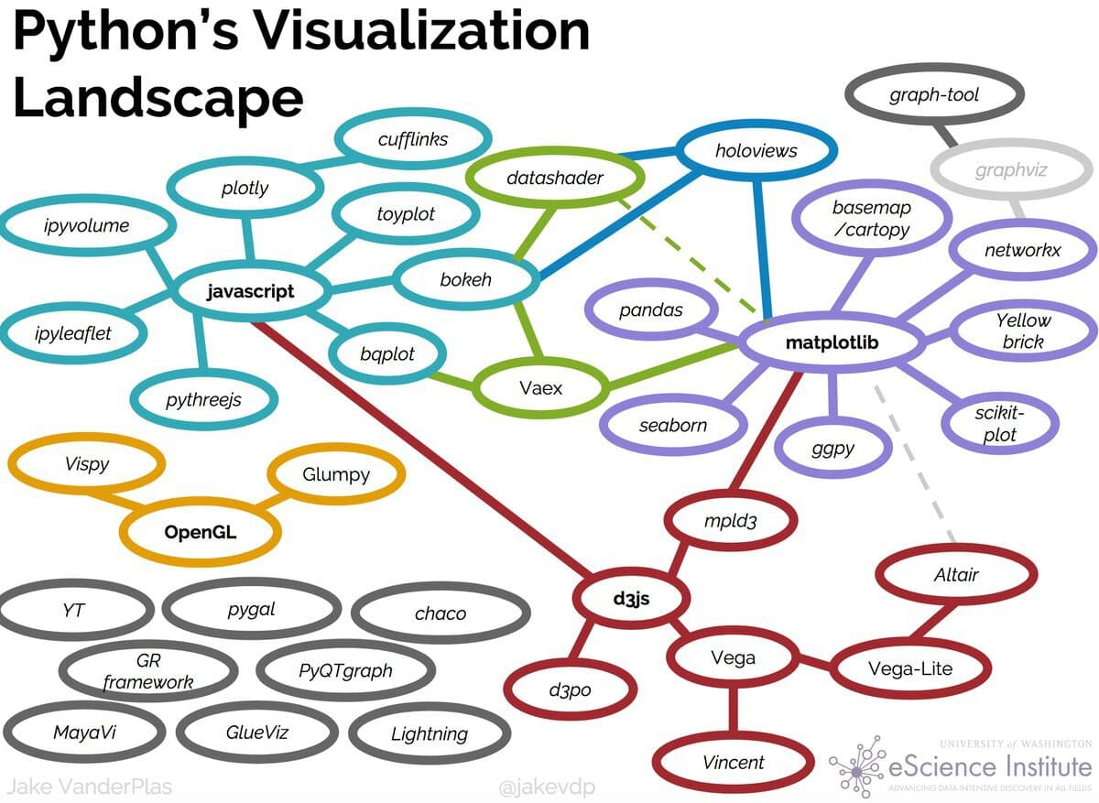

Slide 5

leaflet
r2d3

Slide 6
Strengths
Data
Integration with analysis in R
Based on Grammar of Graphics
Declarative
Succinct
Versatile
Publication ready graphics
(or at least pretty close to it)
Aesthetics
Geometries
Statistics
Facets
Themes

Slide 7
Strengths
Data
Integration with analysis in R
Based on Grammar of Graphics
Declarative
Succinct
Versatile
Publication ready graphics
(or at least pretty close to it)
Aesthetics
Geometries
Statistics
Facets
Themes
Notes:
G of G: Framework for building vis. that relies on layering

Slide 8
Strengths
Integration with analysis in R
Based on Grammar of Graphics
Declarative
Succinct
Versatile
Publication ready graphics
(or at least pretty close to it)
No if/then statements!
No for loops!

Slide 9
Strengths
Integration with analysis in R
Based on Grammar of Graphics
Declarative
Succinct
Versatile
Publication ready graphics
(or at least pretty close to it)

Slide 10
Strengths
Integration with analysis in R
Based on Grammar of Graphics
Declarative
Succinct
Versatile
Publication ready graphics
(or at least pretty close to it)

Slide 11
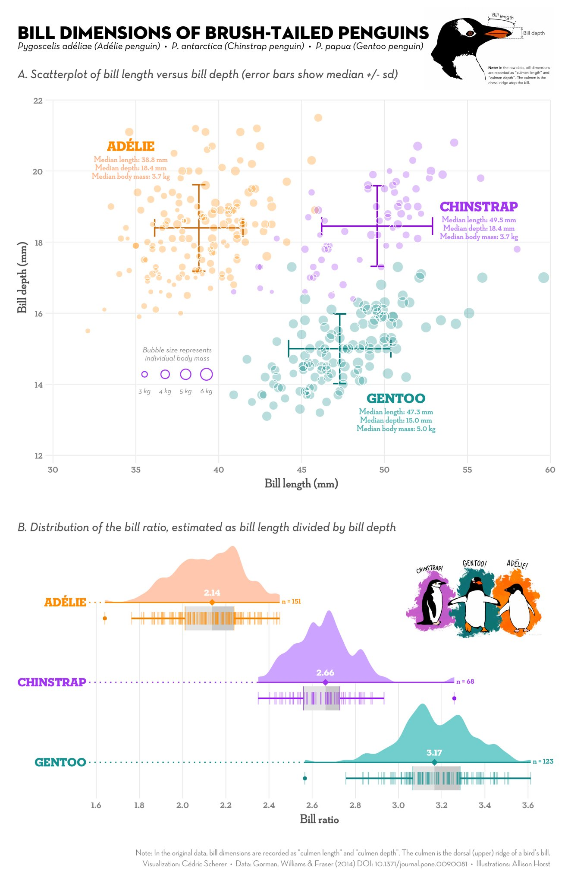

Slide 12
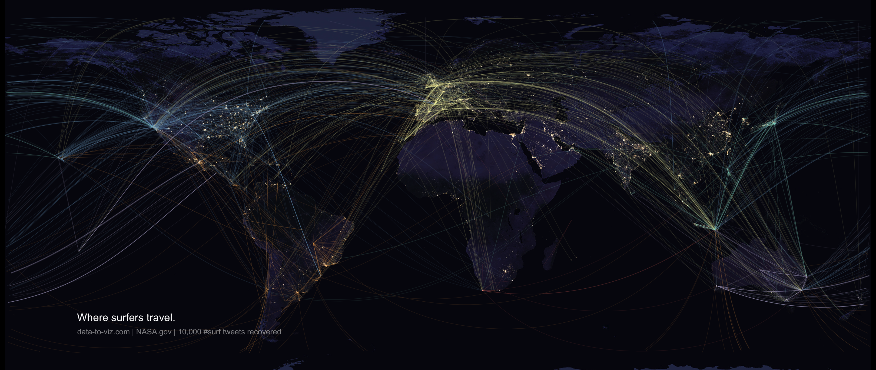

Slide 13
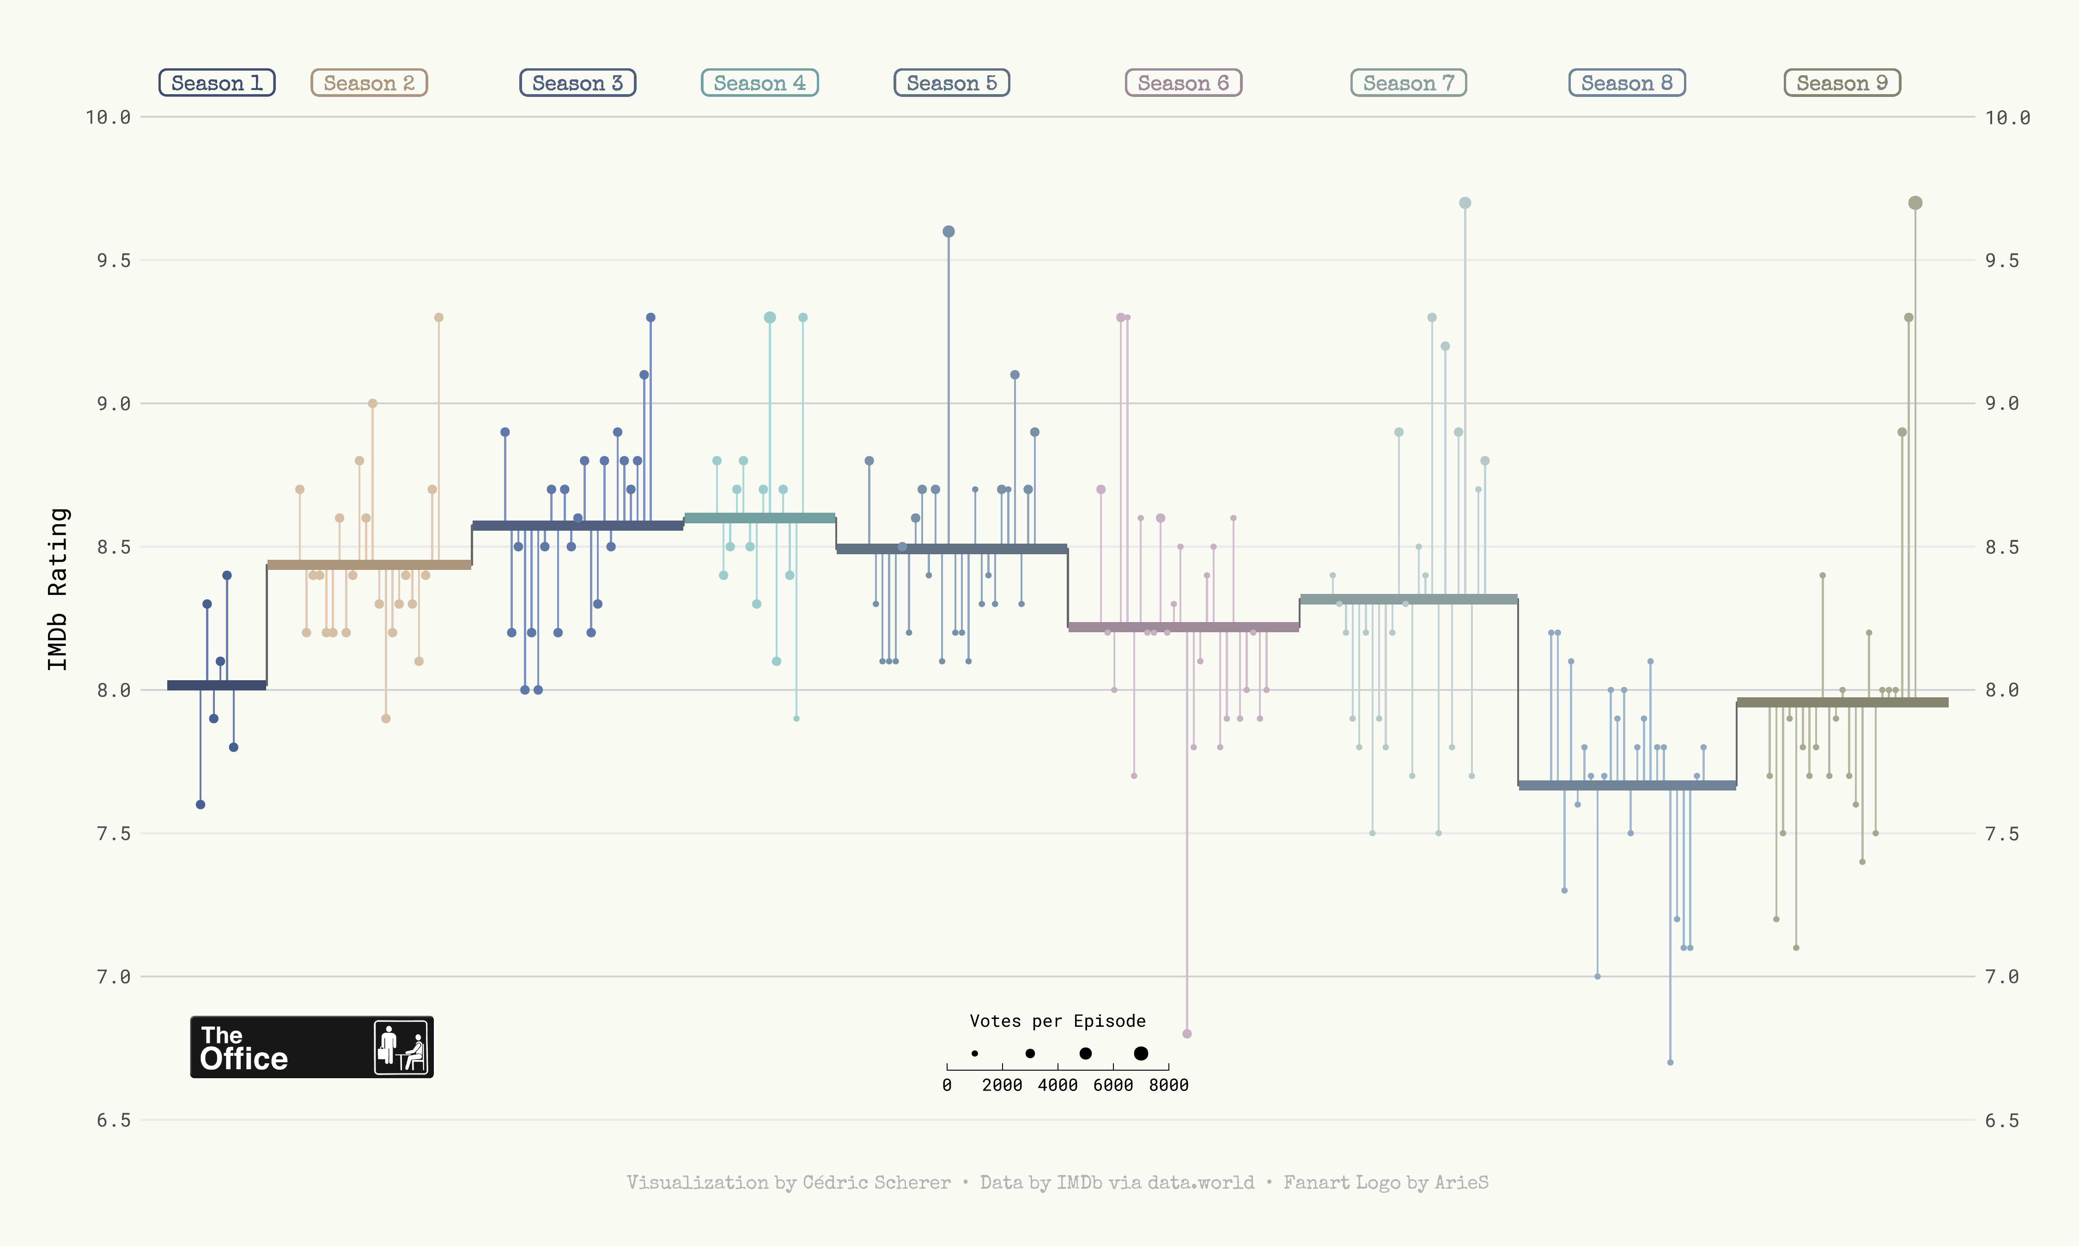

Slide 14
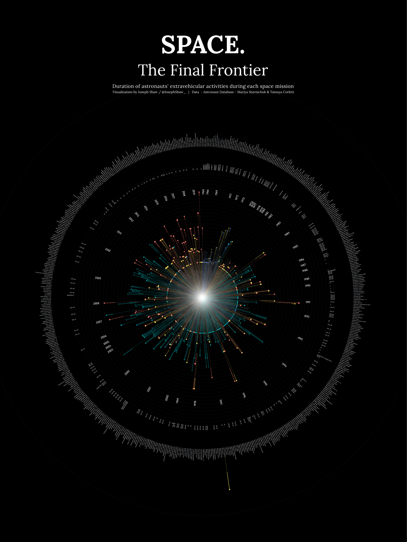
github.com/joseph-shaw/tidytuesday/

Slide 15
github.com/joseph-shaw/tidytuesday/

Slide 16
Strengths
Weaknesses
Integration with analysis in R
Based on Grammar of Graphics
Declarative
Succinct
Versatile
Publication ready graphics
(or at least pretty close to it)

Slide 17
Strengths
Weaknesses
Integration with analysis in R
Based on Grammar of Graphics
Declarative
Succinct
Versatile
Publication ready graphics
(or at least pretty close to it)
Not practical if you’re working in another language
Interactivity not well supported

Slide 18
Strengths
Weaknesses
Integration with analysis in R
Based on Grammar of Graphics
Declarative
Succinct
Versatile
Publication ready graphics
(or at least pretty close to it)
Not practical if you’re working in another language
Interactivity not well supported

Slide 19
Strengths
Weaknesses
Integration with analysis in R
Based on Grammar of Graphics
Declarative
Succinct
Versatile
Publication ready graphics
(or at least pretty close to it)
Not practical if you’re working in another language
Interactivity not well supported
But what about Shiny?!

Slide 20
Data
Aesthetics
Grammar of Graphics
Geometries
Statistics
Facets
Themes
Exporting

Slide 21
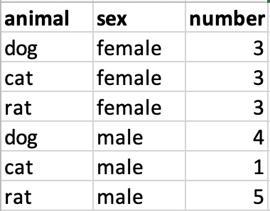
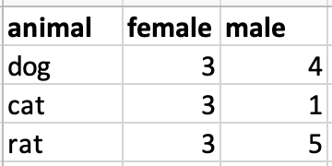
Data Format
Long data (aka. Tidy data)
Wide data

Slide 22
Data Format
Long data
Wide data
f

Slide 23
Data Format
Long data
Wide data
Wide_data = spread(Long_data, sex, number)

Slide 24
Data Format
Long data
Wide data
Long_data = gather(wide_data , sex, number, female:male)

Slide 25
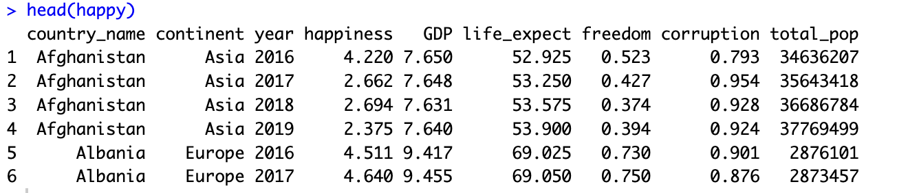

Slide 27
ggplot(data = ,
mapping = aes(x= , ,y= ))+
your data
x axis
y axis
Data
geometry function
Aesthetics
Geometries
Statistics
Facets
Themes
Exporting
Notes:
method chaining with a +

Slide 28
ggplot(data = ,
mapping = aes(x= , ,y= ))+
your data
x axis
y axis
Data
geometry function
Aesthetics
Geometries
ggplot(data = ,
mapping = aes(x= , ,y= ))+
happy
happiness
GDP
Statistics
geom_point()
Facets
Themes
Exporting
Notes:
method chaining with a +

Slide 29
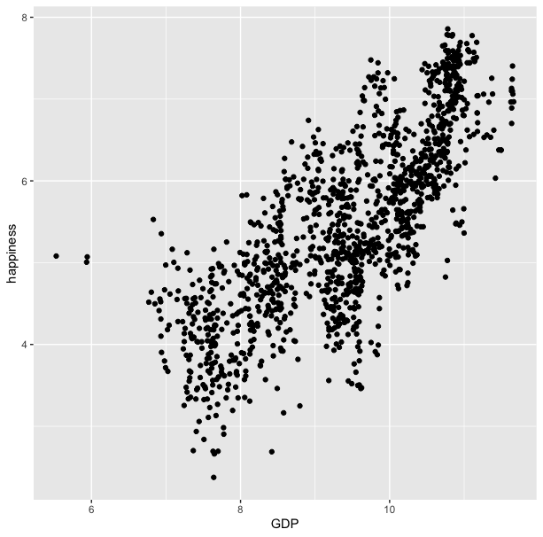
ggplot(data = happy, aes(x=GDP, y=happiness))+
geom_point()

Slide 30
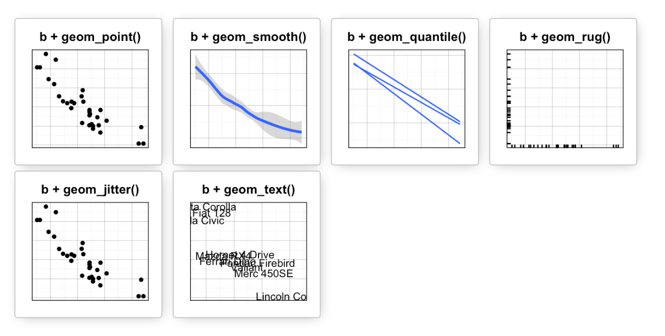
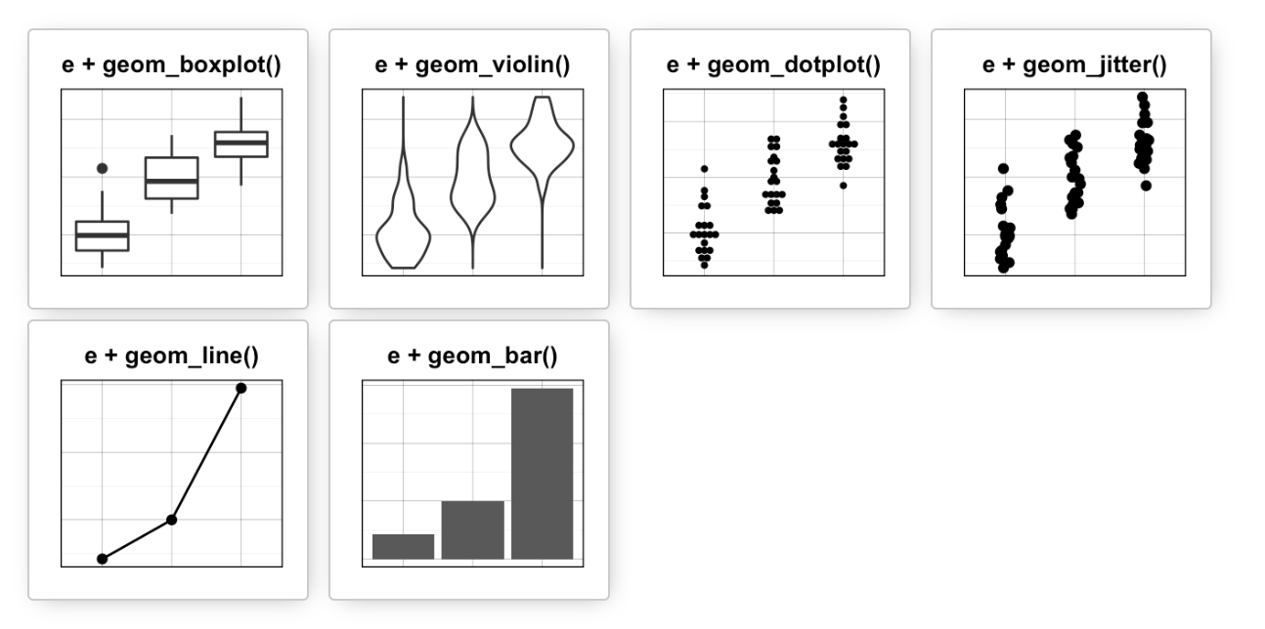
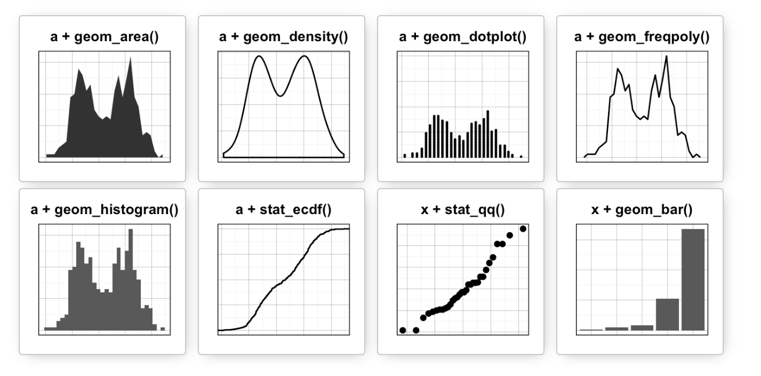
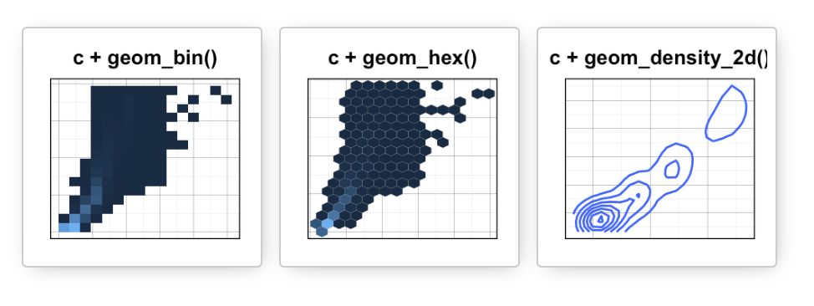
Data
Aesthetics
Geometries
Statistics
Facets
Themes
Exporting

Slide 31
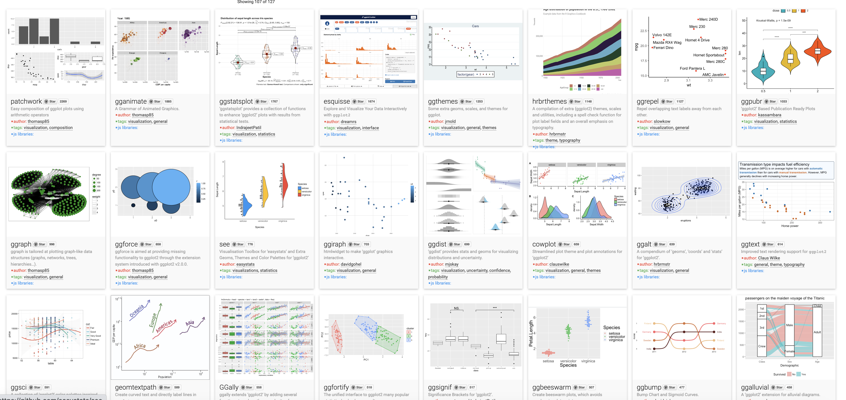
Over 120 ggplot2 extension libraries

Slide 32
ggplot(data = happy, aes(x=GDP, y=happiness))+
geom_point()
“and then…”
dplyr %>% or |>
ggplot +

Slide 33
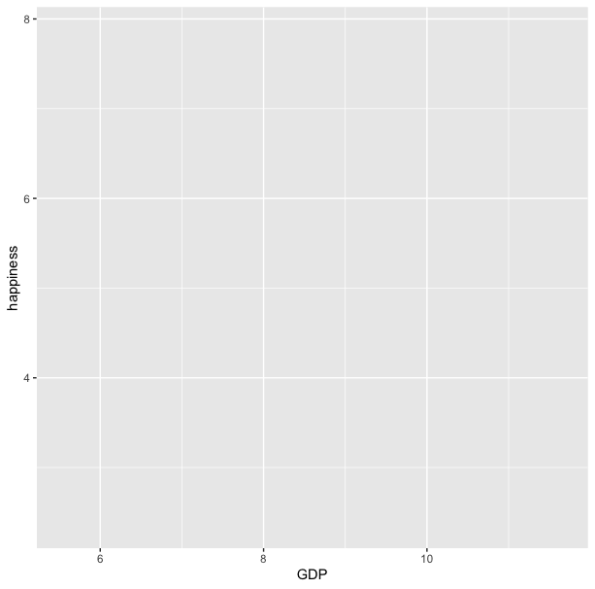
ggplot(data = happy,aes(x=GDP, y=happiness))

Slide 34
ggplot(data = happy, aes(x=GDP, y=happiness))+
geom_point()

Slide 35
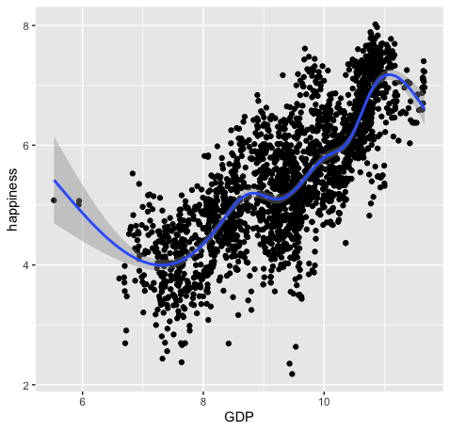
ggplot(data = happy, aes(x=GDP, y=happiness))+
geom_point()+
geom_smooth()

Slide 36
ggplot(data = happy,
mapping = aes(x=GDP, y=happiness))+
geom_point()

Slide 37
ggplot(data = happy,
mapping = aes(x=GDP, y=happiness))+
geom_point()
ggplot(happy, aes(GDP, happiness))+
geom_point()

Slide 38
ggplot(data = happy,
mapping = aes(x=GDP, y=happiness))+
geom_point()
ggplot(happy, aes(GDP, happiness))+
geom_point()
ggplot()+
geom_point(happy,aes(GDP,happiness))

Slide 39
ggplot(data = happy,
mapping = aes(x=GDP, y=happiness))+
geom_point()
ggplot(happy, aes(GDP, happiness))+
geom_point()
ggplot()+
geom_point(happy,aes(GDP,happiness))
happy %>%
ggplot(aes(GDP,happiness))+
geom_point()

Slide 40
ggplot(data = happy,
mapping = aes(x=GDP, y=happiness))+
geom_point()
ggplot(happy, aes(GDP, happiness))+
geom_point()
ggplot()+
geom_point(happy,aes(GDP,happiness))
happy %>%
ggplot(aes(GDP,happiness))+
geom_point()
These all produce the same figure!

Slide 41
Aesthetics define any data that gets mapped to geometry
(such as color, size, shape, etc.)
Data
Aesthetics
Geometries
Statistics
ggplot(data = yourData,
aes(x = xaxis,y = yaxis))+
geom_point()
Facets
Themes
Exporting
Notes:
method chaining with a +

Slide 42
Aesthetics define any data that gets mapped to geometry
(such as color, size, shape, etc.)
Data
Aesthetics
Geometries
Statistics
ggplot(data = happy,
aes(x = happiness,y = GDP))+
geom_point()
ggplot(data = yourData,
mapping = aes(x = xaxis,y = yaxis))+
geom_point()
Facets
Themes
Exporting
Notes:
method chaining with a +

Slide 44
ggplot(happy, aes(GDP, happiness)) +
geom_point()

Slide 45
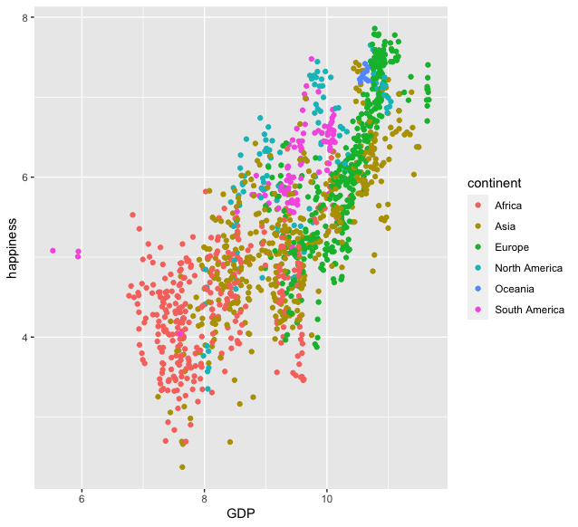
ggplot(happy, aes(GDP, happiness)) +
geom_point(aes(col=continent))

Slide 46
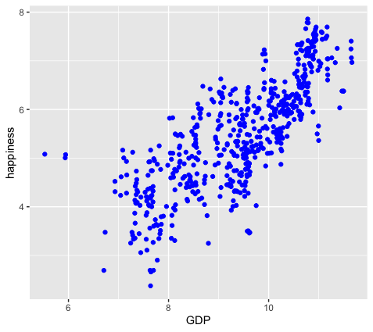
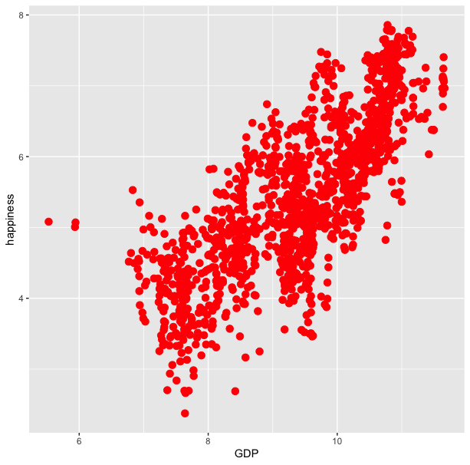
ggplot(happy, aes(GDP, happiness)) +
geom_point(aes(col=continent))
ggplot(happy, aes(GDP, happiness)) +
geom_point(col=‘blue’)

Slide 47
ggplot(happy, aes(GDP, happiness)) +
geom_point(aes(col=continent))
ggplot(happy, aes(GDP, happiness)) +
geom_point(col=‘blue’)
ggplot(happy, aes(GDP, happiness)) +
geom_point(aes(col=‘blue’))

Slide 48
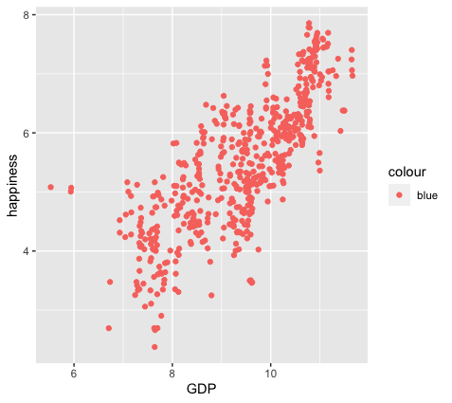
ggplot(happy, aes(GDP, happiness)) +
geom_point(aes(col=continent))
ggplot(happy, aes(GDP, happiness)) +
geom_point(col=‘blue’)
ggplot(happy, aes(GDP, happiness)) +
geom_point(aes(col=‘blue’))

Slide 49
colour
blue
blue
blue
blue
blue
blue
ggplot(happy, aes(GDP, happiness)) +
geom_point(aes(col=‘blue’))

Slide 50
ggplot(happy, aes(GDP, happiness)) +
geom_point()
We can also set conditional formatting.
e.g. Use different colors for points where happiness is > 5

Slide 51
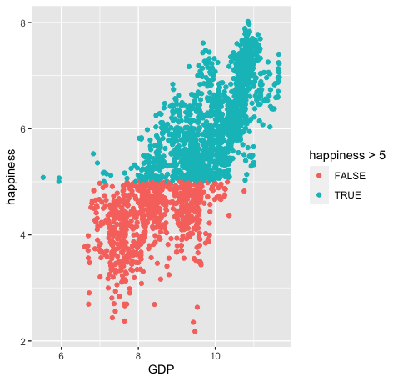
ggplot(happy, aes(GDP, happiness)) +
geom_point()
ggplot(happy, aes(GDP, happiness)) +
geom_point(aes(col=happiness > 5)

Slide 52
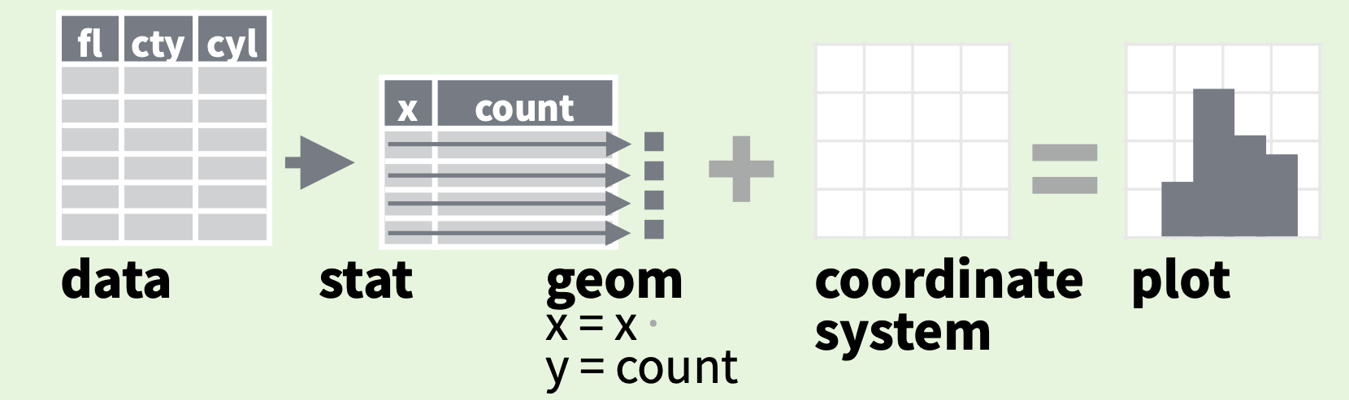
Data
Aesthetics
Geometries
Statistics
Facets
Themes
Exporting

Slide 53
stat
Every geom function specifies a stat
Use a stat function (calls a default geom to make a layer)
Data
Aesthetics
Geometries
Statistics
Facets
Themes
Exporting

Slide 54
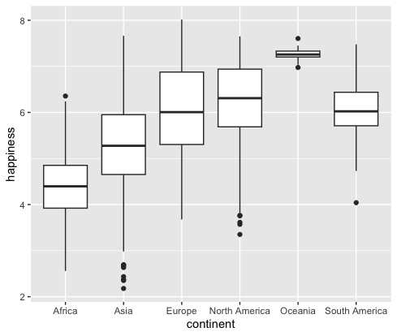
stat
Every geom function specifies a stat
Use a stat function (calls a default geom to make a layer)
ggplot(happy, aes(continent, happiness)) +
geom_boxplot()

Slide 55
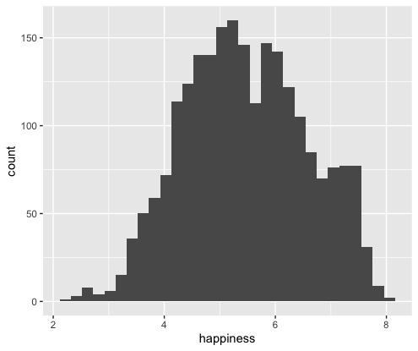
stat
Every geom function specifies a stat
Use a stat function (calls a default geom to make a layer)
ggplot(happy, aes(happiness)) +
geom_histogram()

Slide 56
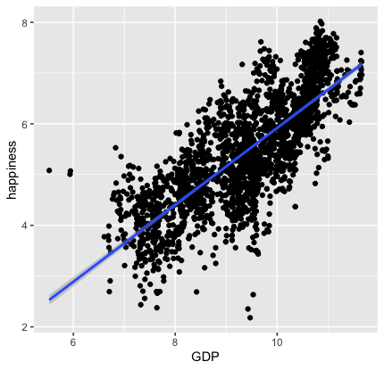
stat
Every geom function specifies a stat
Use a stat function (calls a default geom to make a layer)
ggplot(happy, aes(GDP, happiness)) +
geom_point()+
stat_smooth(method = "lm",
formula = y ~ x)

Slide 57
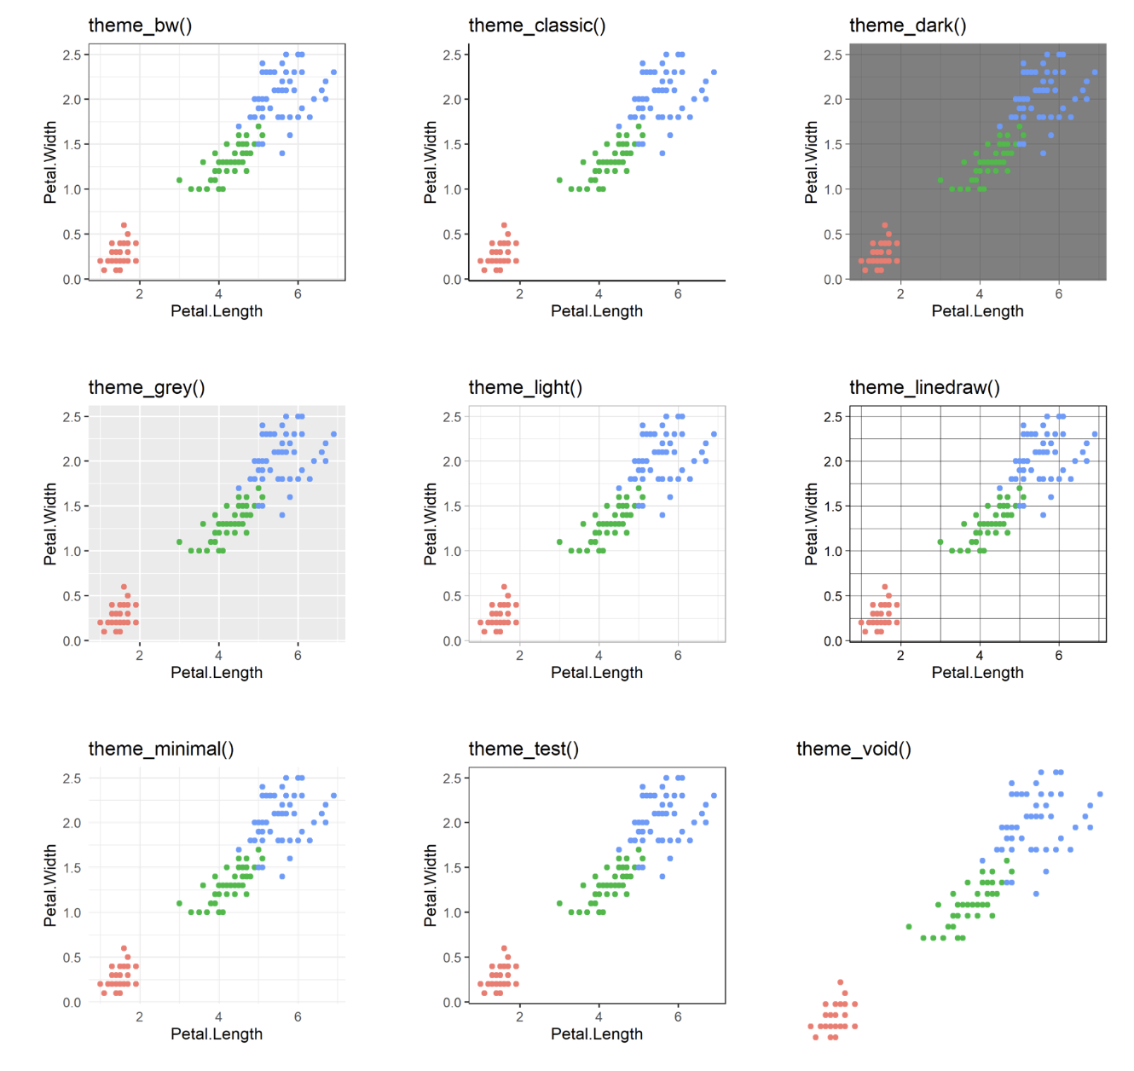
60 preexisting themes
easy to call
Data
Aesthetics
Geometries
Statistics
Facets
Themes & scales
Exporting

Slide 58
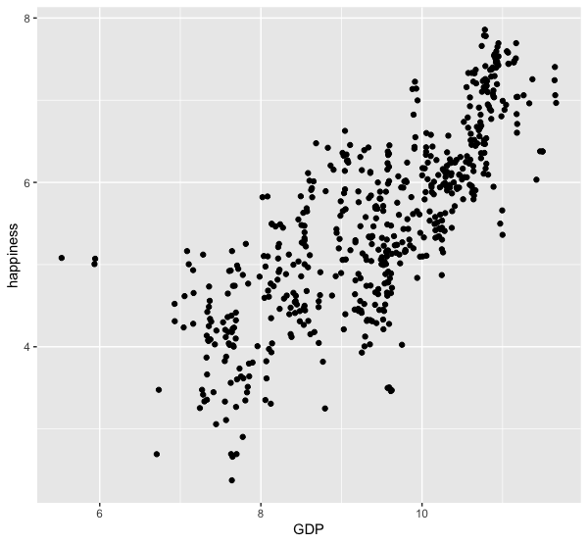
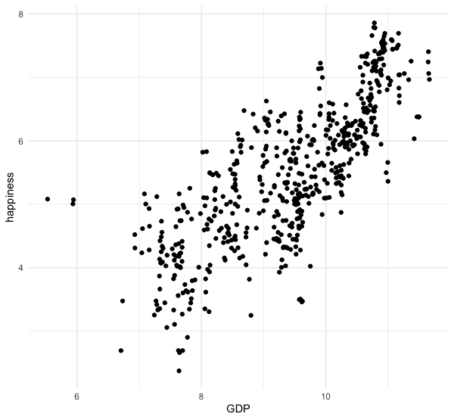
ggplot(happy, aes(GDP, happiness))+
geom_point()
ggplot(happy, aes(GDP, happiness))+
geom_point()+
theme_minimal()

Slide 59
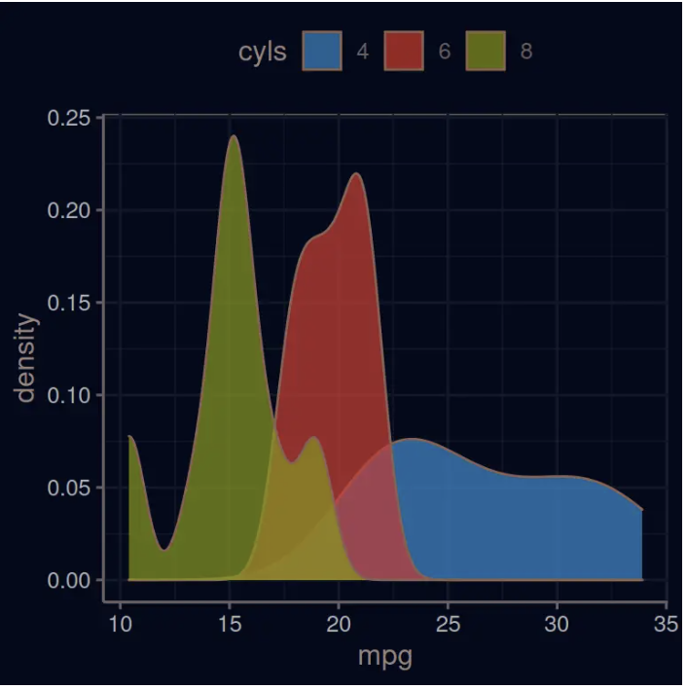
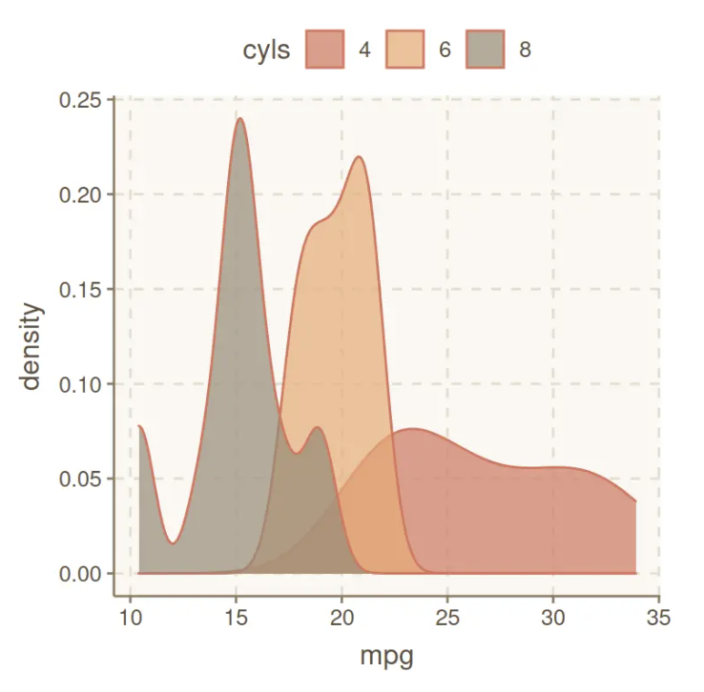
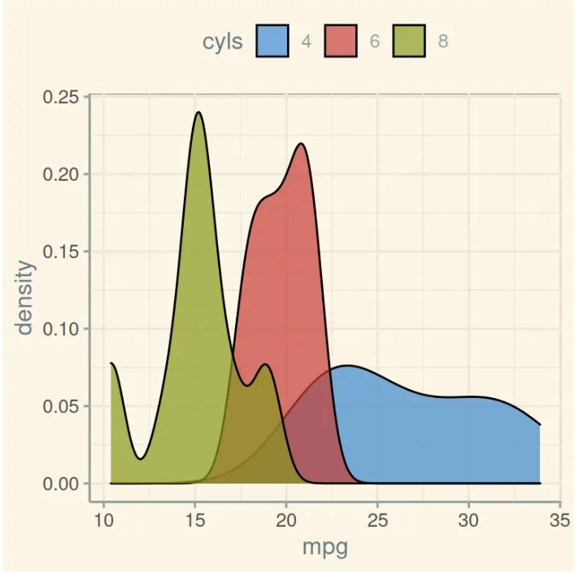
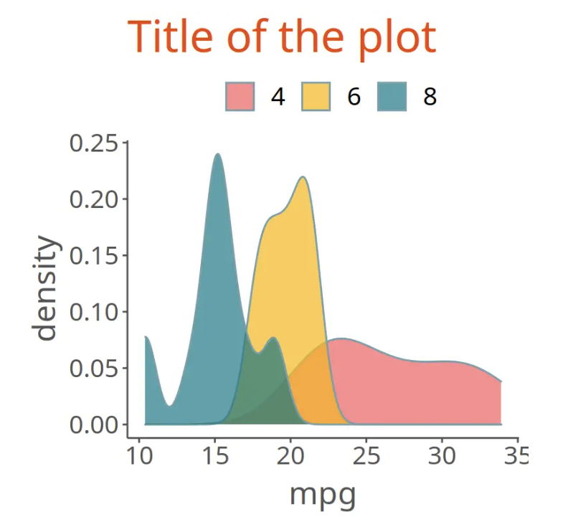
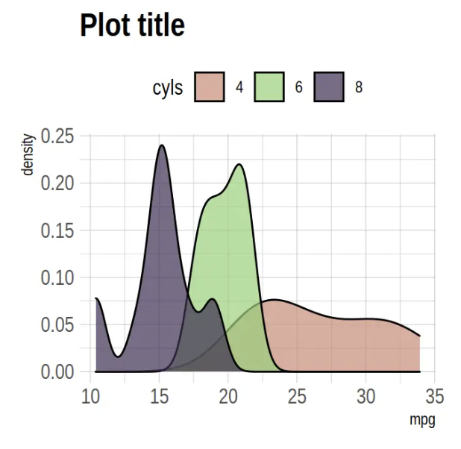
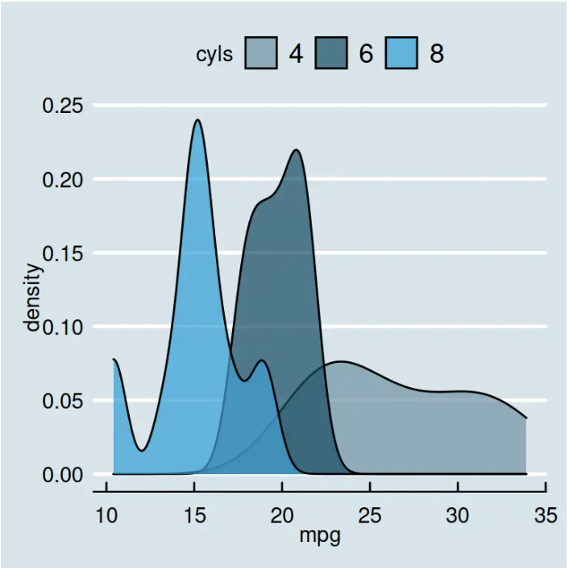
Over 60 pre-existing themes
Data
Aesthetics
Geometries
Statistics
Facets
Themes & scales
Exporting
https://r-charts.com/ggplot2/themes/

Slide 60
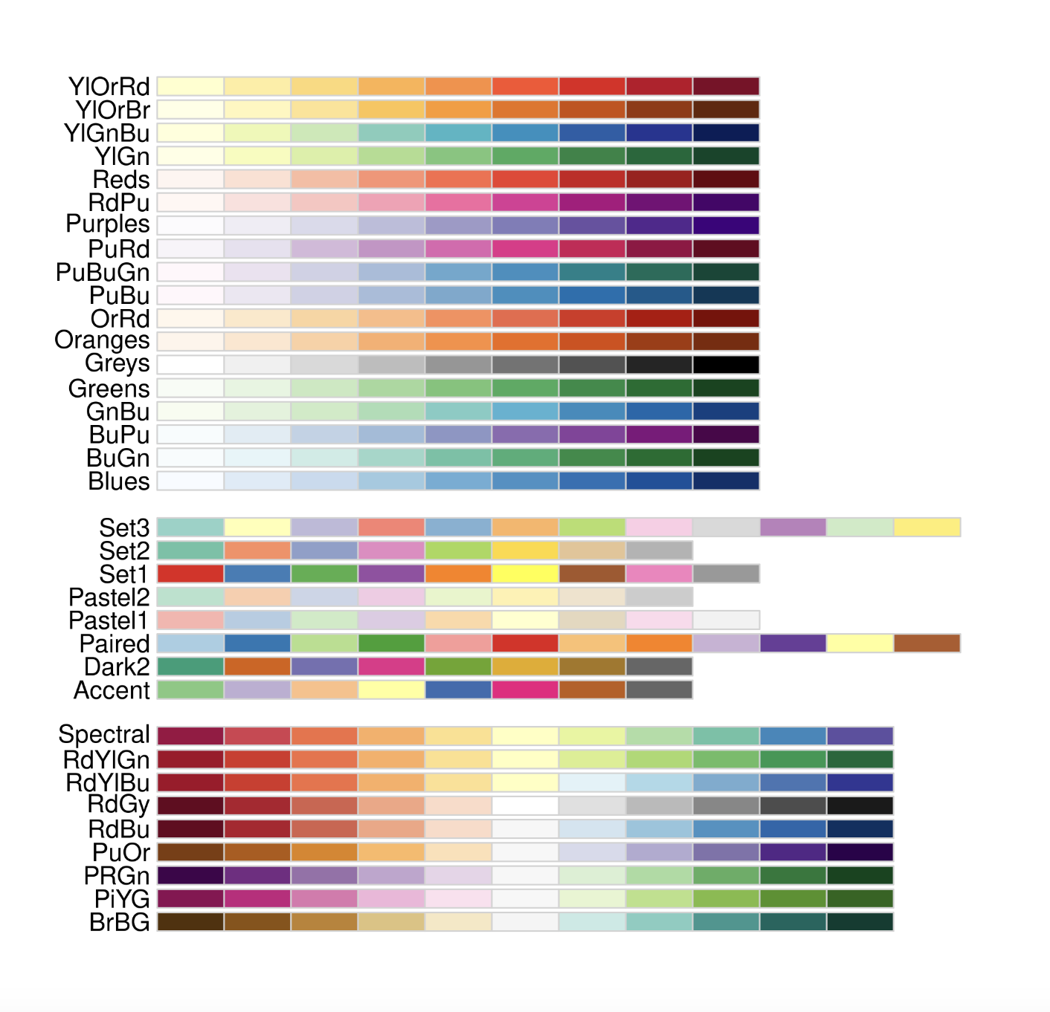
Brewer Scales
Data
Aesthetics
Geometries
Statistics
Facets
Themes & scales
Exporting

Slide 61
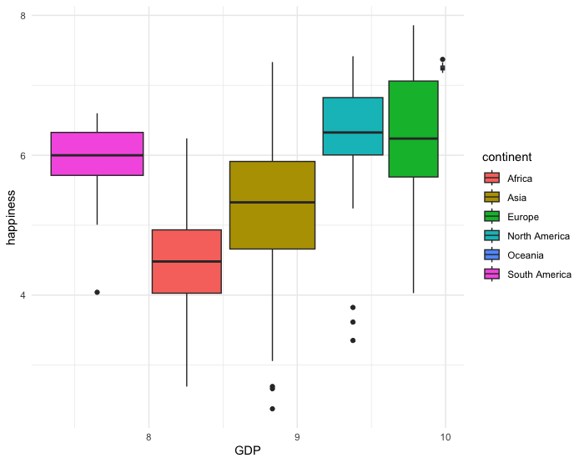
Brewer Scales
ggplot(happy, aes(GDP, happiness))+
geom_boxplot(aes(fill=continent)) +
theme_minimal

Slide 62
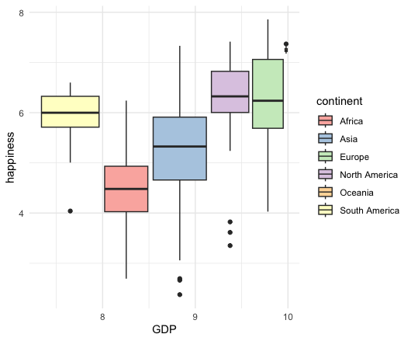
Brewer Scales
ggplot(happy, aes(GDP, happiness))+
geom_boxplot(aes(fill=continent)) +
theme_minimal()+
scale_fill_brewer(palette = "Set3")

Slide 63
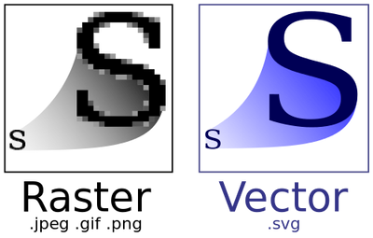
Data
Aesthetics
Geometries
Statistics
Facets
.pdf
Themes
Exporting

Slide 64
Lets give it a try

Slide 65
Strengths
Data
Integration with analysis in R
Based on Grammar of Graphics
Declarative
Succinct
Versatile
Publication ready graphics
(or at least pretty close to it)
Aesthetics
Geometries
Statistics
Facets
Themes

Slide 66
Strengths
Data
Integration with analysis in R
Based on Grammar of Graphics
Declarative
Succinct
Versatile
Publication ready graphics
(or at least pretty close to it)
Aesthetics
Geometries
Statistics
Facets
Themes

Slide 67
Data
Aesthetics
Geometries
Statistics
Facets
Themes
Exporting

Slide 68
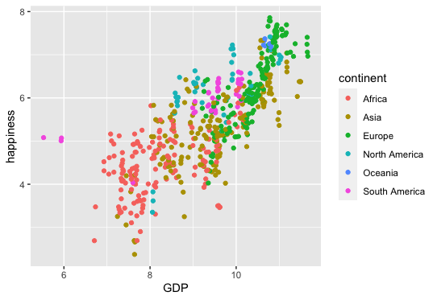
ggplot(happy, aes(GDP, happiness))+
geom_point(aes(col=continent))

Slide 69
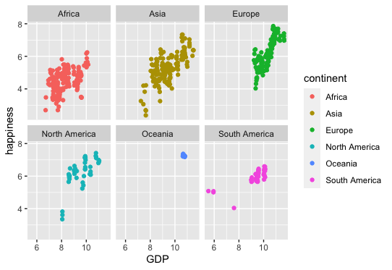
ggplot(happy, aes(GDP, happiness))+
geom_point(aes(col=continent))
ggplot(happy, aes(GDP, happiness))+
geom_point(aes(col=continent))+
facet_wrap(~continent)

